Slide 1

Psychedelic Crash Course
The History, The Science, and The Phenomenology

Slide 2

What’s a psychedelic

Slide 3
_
Psyche + delos

Slide 4

” Mind-Manifesting”

Slide 5
Psilocybin
DMT
Ketamine
LSD
Mescaline
MDMA

Slide 6
Psilocybin
DMT
Ketamine
LSD
Mescaline
MDMA

Slide 7
Psilocybin
DMT
Ketamine
LSD
Mescaline
MDMA

Slide 8
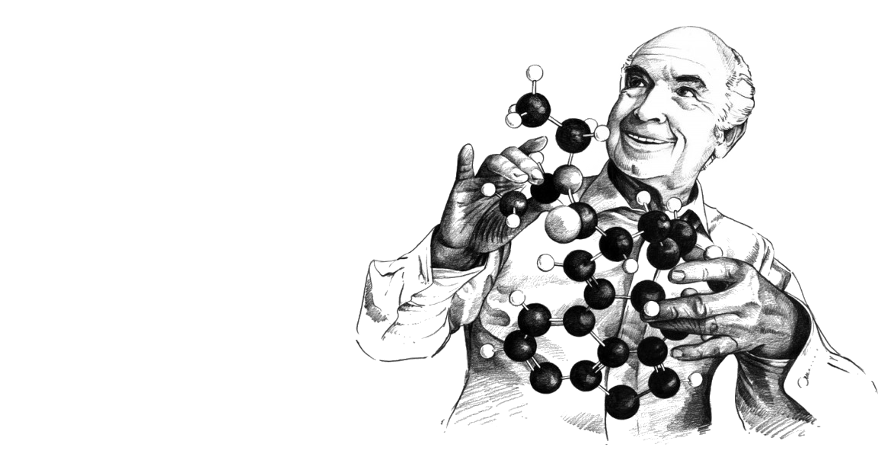
LSD
Lysergic Acid Diethylamide
- Discovered by Swiss chemist Albert Hofmann in 1943
- Odorless, tasteless substance derived from moldy rye
- Accidentally ingested trace amounts

Slide 9
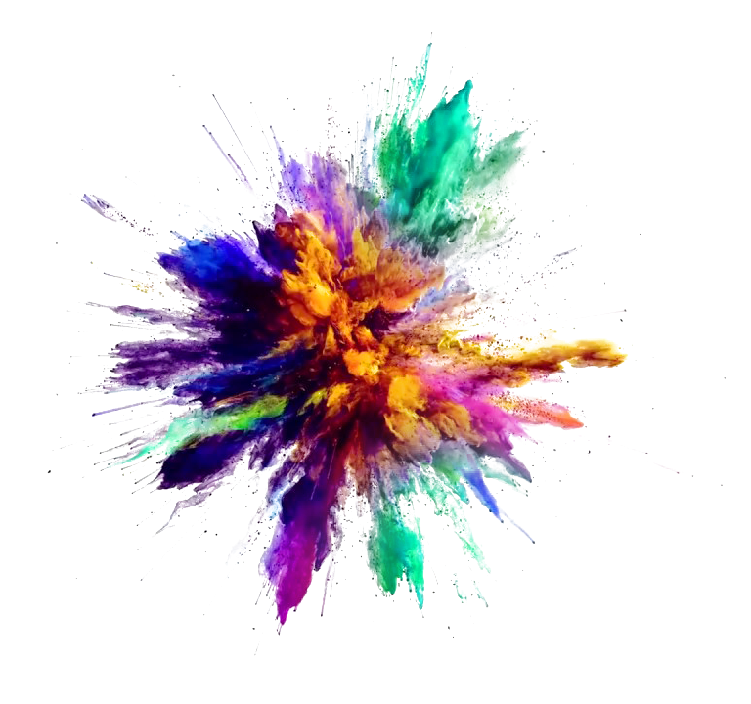
LSD
Lysergic Acid Diethylamide
“250 micrograms
should be enough!”

Slide 10
LSD
Lysergic Acid Diethylamide
“Every exertion of my will, every attempt to put an end to the disintegration of the outer world and the dissolution of my ego, seemed to be wasted effort (…)
A demon had invaded me, had taken possession of my body, mind, and soul (…)
Was I dying? Was this the transition?”
Hofmann (1980).

Slide 11
LSD
Lysergic Acid Diethylamide
“[The doctor] conveyed me to my bed and stood watch over me. Slowly I came back from a weird, unfamiliar world. The horror softened and gave way to a feeling of good fortune and gratitude (…)
Kaleidoscopic, fantastic images surged in on me … exploding in colored fountains, rearranging and hybridizing themselves in constant flux.”
Hofmann (1980).

Slide 12
LSD
Lysergic Acid Diethylamide
“A sensation of well-being and renewed life flowed through me. Breakfast tasted delicious and gave me extraordinary pleasure.
When I later walked out into the garden, in which the sun shone now after a spring rain, everything glistened and sparkled in a fresh light.
The world was as if newly created.”
Hofmann (1980).

Slide 13

LSD
Lysergic Acid Diethylamide

Slide 14
LSD
Lysergic Acid Diethylamide
This could have therapeutic uses

Slide 15
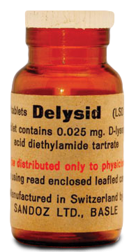
LSD
Lysergic Acid Diethylamide
This could have therapeutic uses
Sandison (2001).

Slide 16
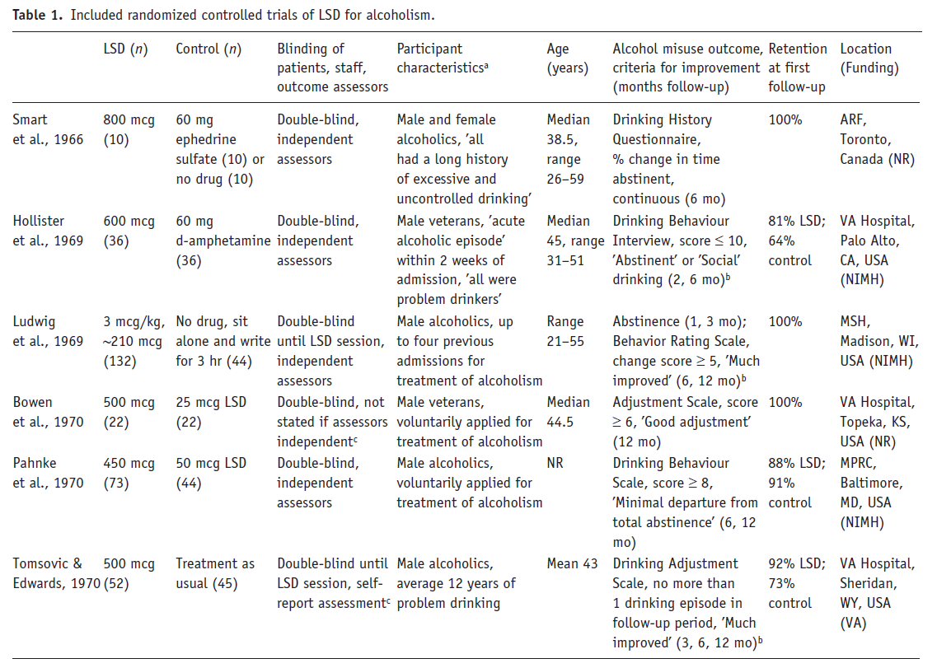
LSD
Lysergic Acid Diethylamide
Krebs & Johansen (2012).

Slide 17
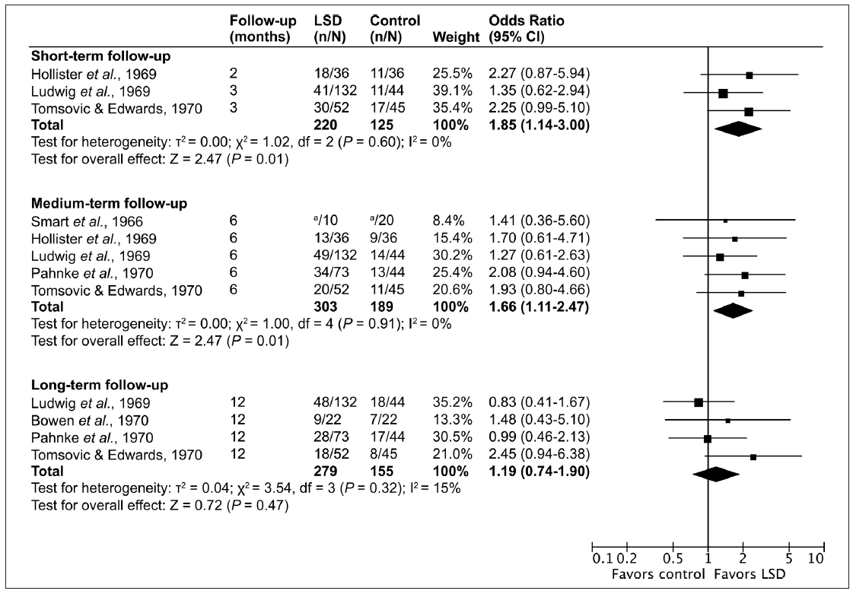
LSD
Lysergic Acid Diethylamide
Krebs & Johansen (2012).

Slide 18
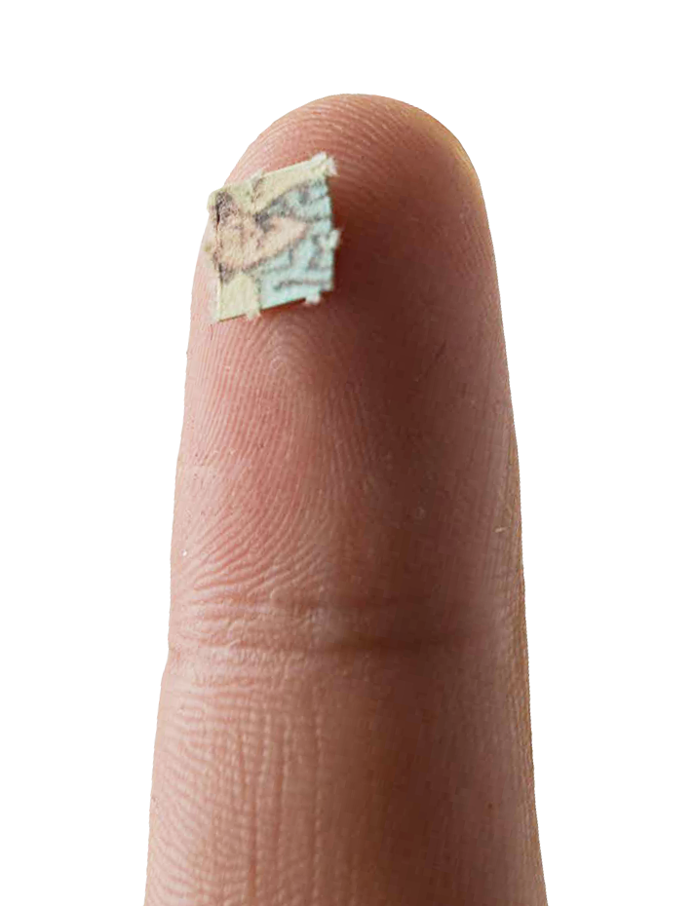
LSD
Lysergic Acid Diethylamide
Krebs & Johansen (2012).

Slide 19

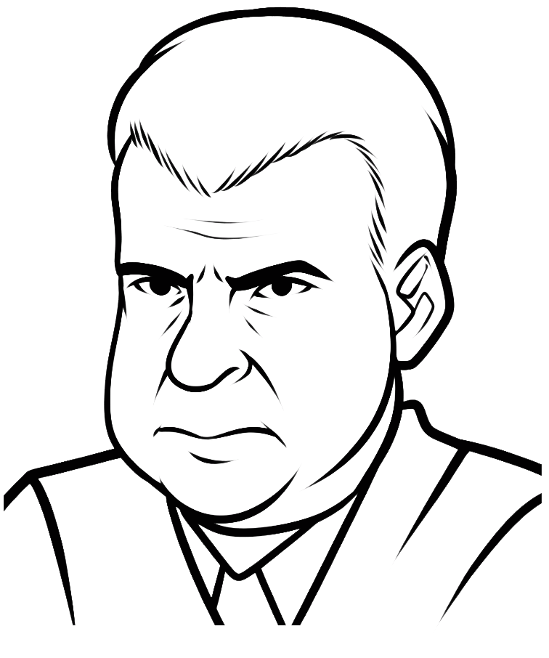

LSD
Lysergic Acid Diethylamide

Slide 20
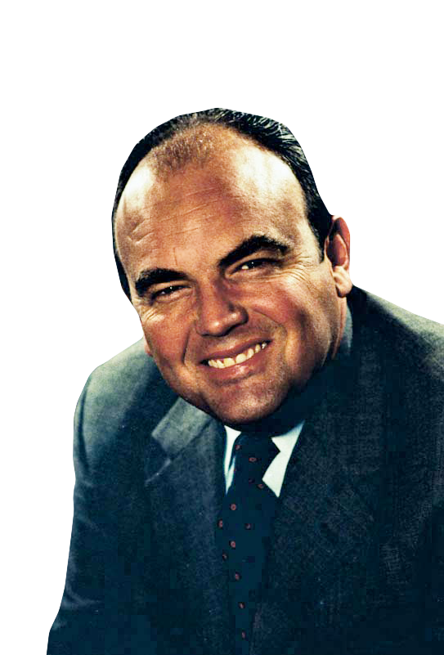
LSD
Lysergic Acid Diethylamide
"The Nixon campaign in 1968, and the Nixon White House after that, had two enemies: the antiwar left and black people.
You understand what I'm saying? We knew we couldn't make it illegal to be either against the war or black, but by getting the public to associate the hippies with marijuana and blacks with heroin, and then criminalizing both heavily, we could disrupt those communities.
Did we know we were lying about the drugs?
Of course we did."
John Ehrlichman, advisor to President Nixon
Baum (2016)

Slide 21
35 years later. . .

Slide 22
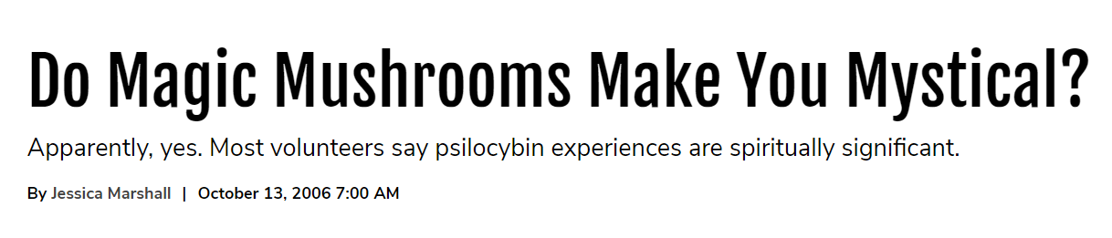
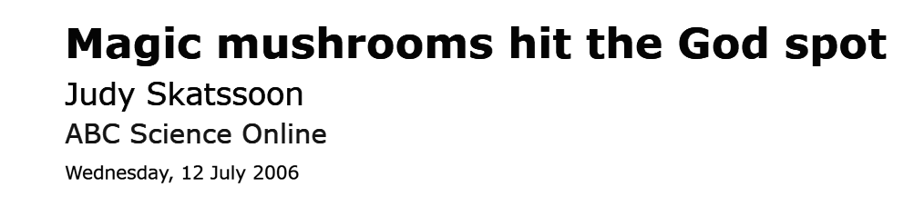
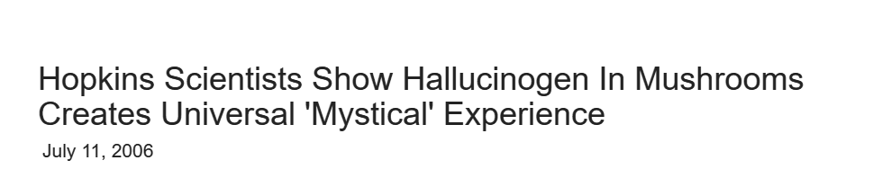
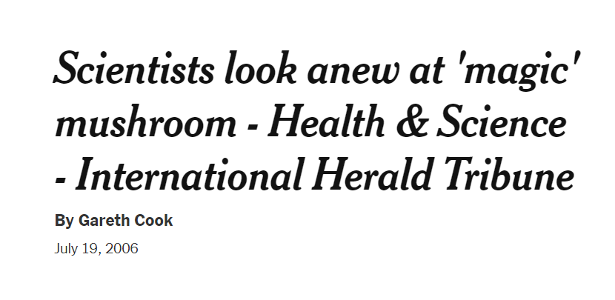

Slide 23
What happened

Slide 24
Psilocybin
DMT
Ketamine
LSD
Mescaline
MDMA

Slide 25
Psilocybin
DMT
Ketamine
LSD
Mescaline
MDMA

Slide 26
Psilocybin
DMT
Ketamine
LSD
Mescaline
MDMA

Slide 27
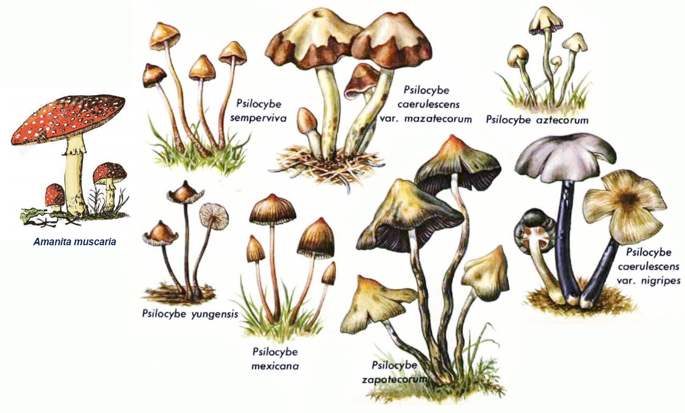
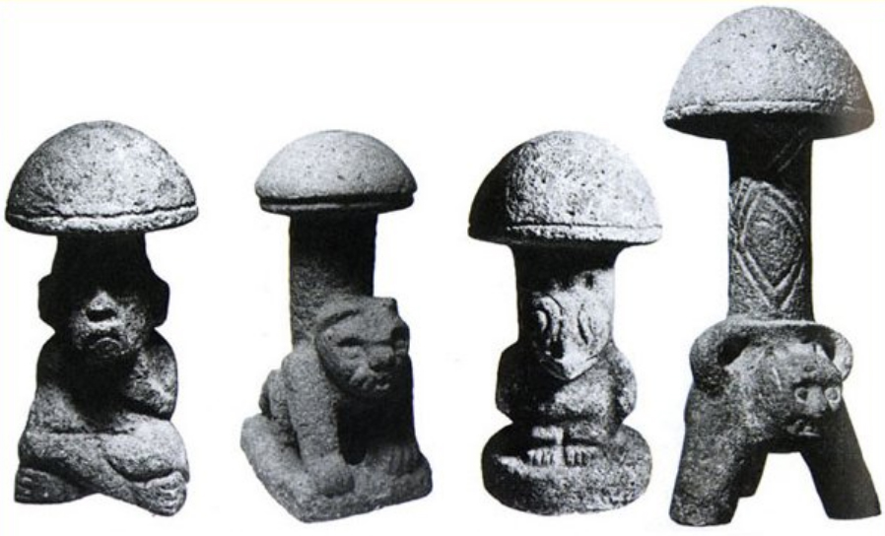
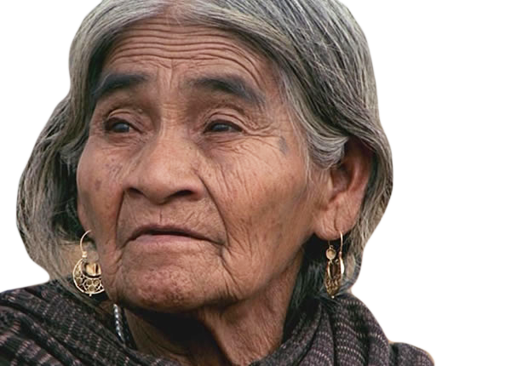
Psilocybin
” Magic Mushrooms”
- Several types, all grow in the wild
- Used ritually for centuries
- Introduced to the West by María Sabina in 1955
Rudgley (1993); Sessa (2017)

Slide 28
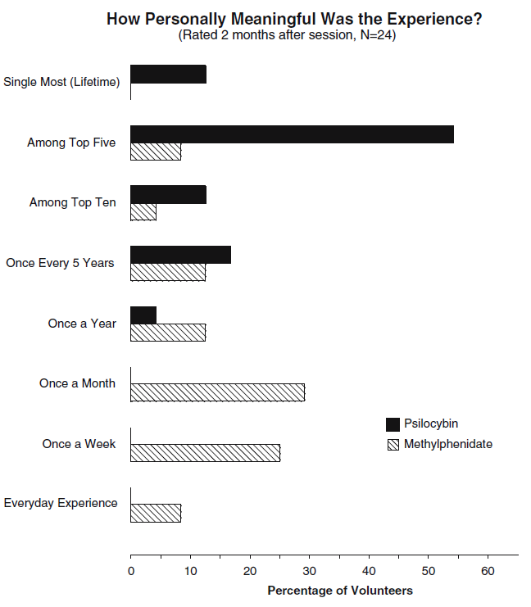
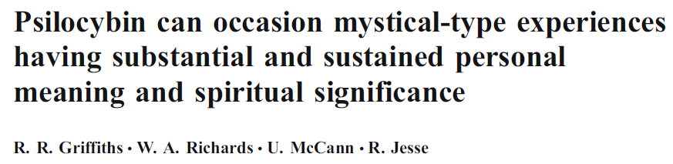
Griffiths et al. (2006)
Psilocybin
” Magic Mushrooms”
Psilocybin vs active placebo
Double-blind, between-group, crossover study
n = 36 (14 male)
Mean age = 46 years
Highly educated (97% graduates; 56% post-graduates)
Subjected to various questionnaires post

Slide 29
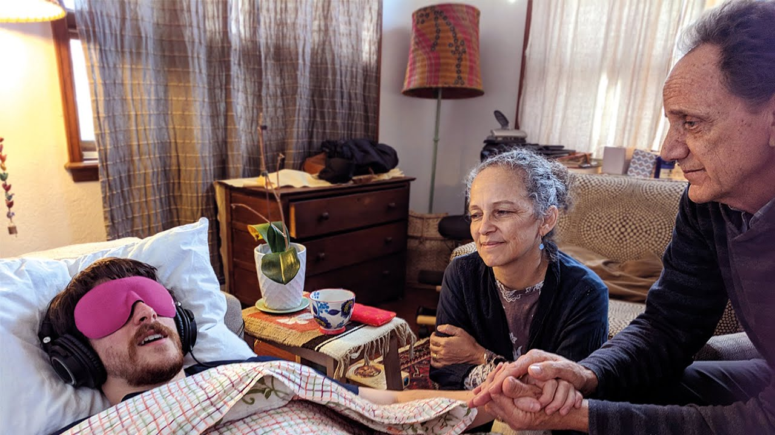
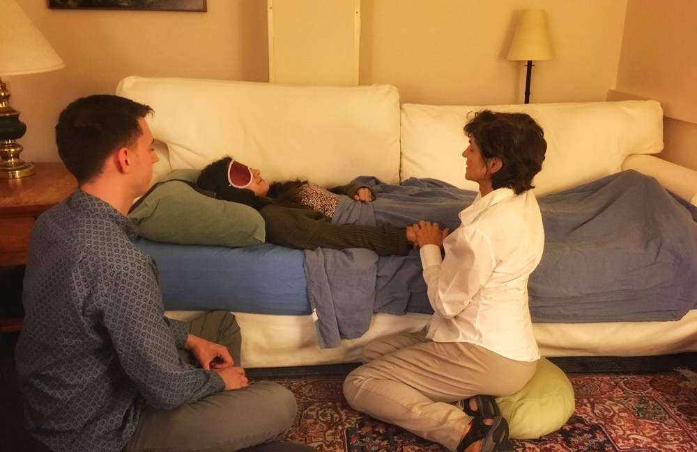
Psilocybin
” Magic Mushrooms”

Slide 30
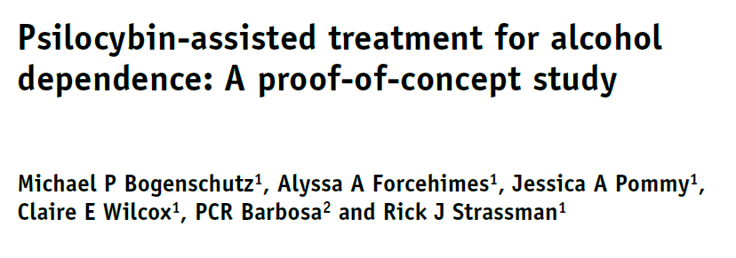
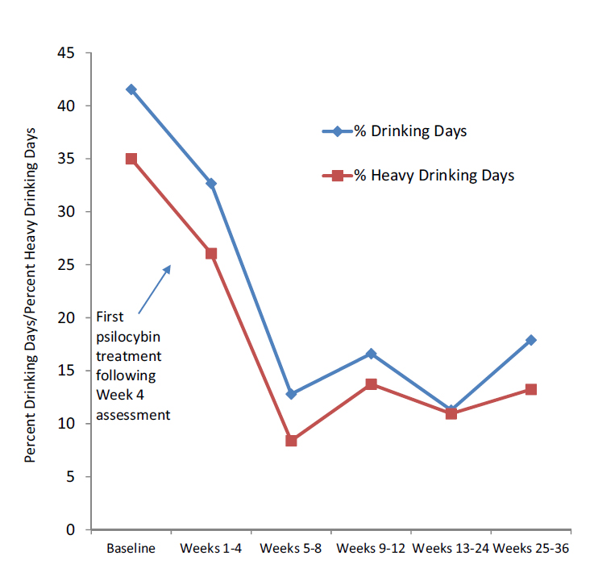
Psilocybin
Addiction
” Magic Mushrooms”
Bogenschutz et al. (2015)
Pilot study on alcoholism
n = 10
Intensity of effects predicted outcome
Effect remained at 6 months follow-up
New study underway at NYU
n = 180
Results expected in 2020

Slide 31
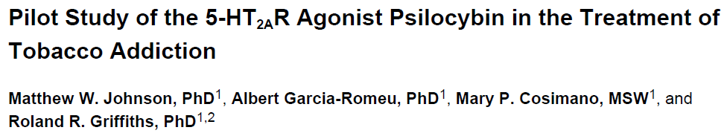
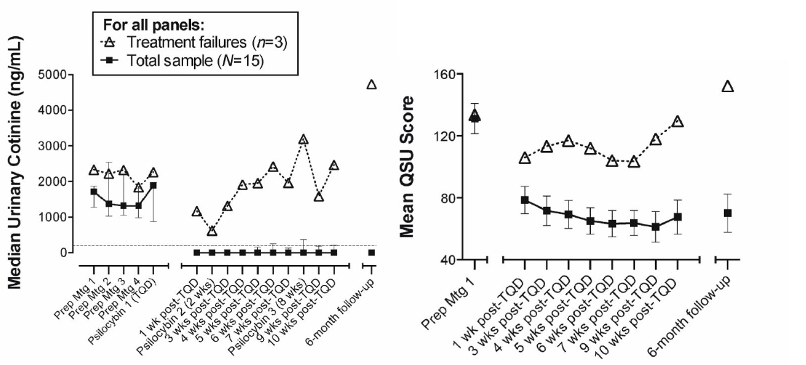
Psilocybin
Addiction
” Magic Mushrooms”
Johnson et al. (2014)
Pilot study on nicotine addiction
n = 15
Average years of smoking = 31
Average attempts to quit = 6
Nicotine content of urine
Smoking urge questionnaire

Slide 32
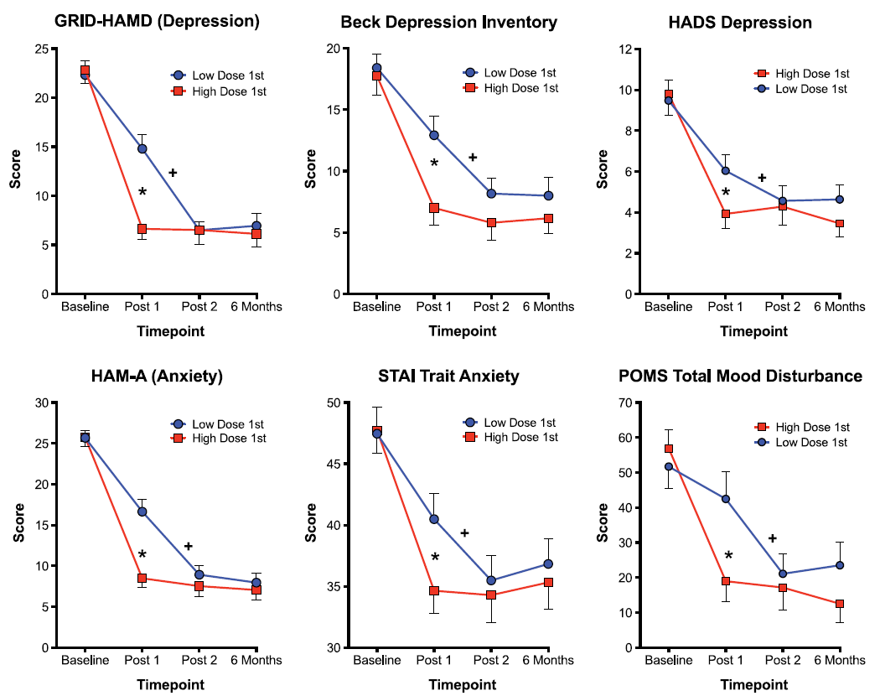
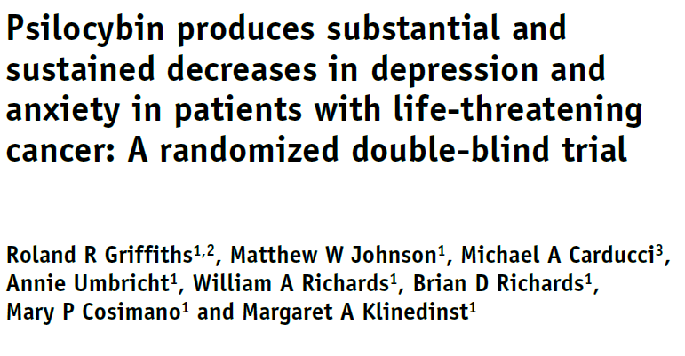
Psilocybin
Anxiety
” Magic Mushrooms”
Griffiths et al. (2016)
Study on late-stage cancer induced anxiety
n = 51
All participants had life-threatening cancer
All had a DSM-IV diagnosis (anxiety or depression)

Slide 33
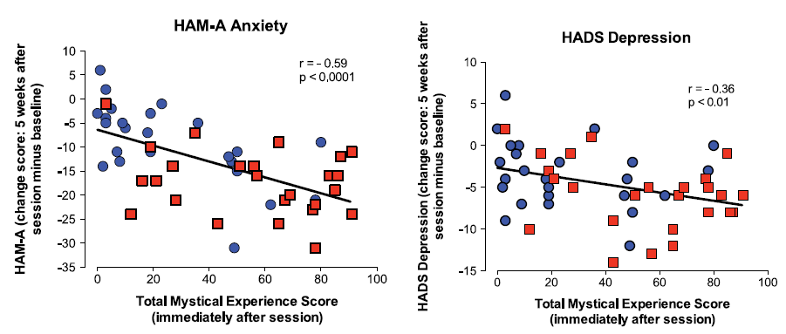
Psilocybin
Anxiety
” Magic Mushrooms”
Griffiths et al. (2016)
Study on late-stage cancer induced anxiety
n = 51
All participants had life-threatening cancer
All had a DSM-IV diagnosis (anxiety or depression)

Slide 34
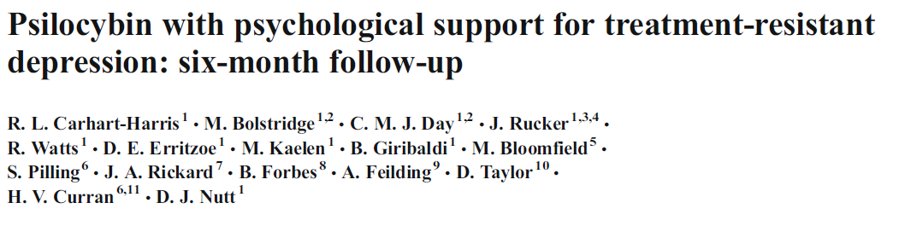
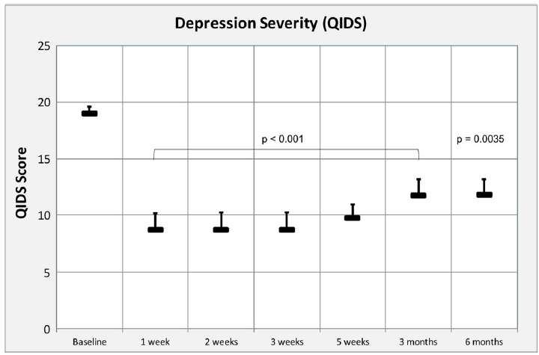
Psilocybin
Depression
” Magic Mushrooms”
Carhart-Harris et al. (2018)
Study on treatment-resistent depression
n = 20
Mean number of failed medications = 4
Mean years of depression = 17.7
Two dosing sessions
9 participants responded to treatment
New study underway
n = 80
Results expected in 2021

Slide 35
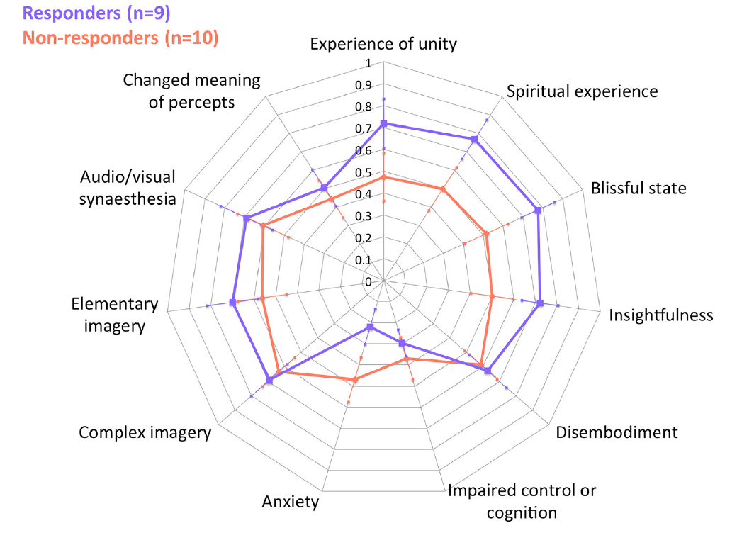
Psilocybin
Depression
” Magic Mushrooms”
Carhart-Harris et al. (2018)
Study on treatment-resistent depression
n = 20
Mean number of failed medications = 4
Mean years of depression = 17.7
Two dosing sessions
9 participants responded to treatment
New study underway
n = 80
Results expected in 2021
Roseman et al. (2018)

Slide 36
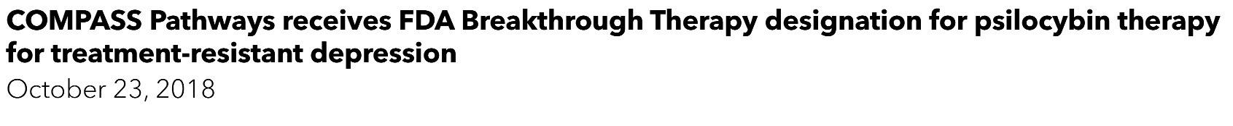
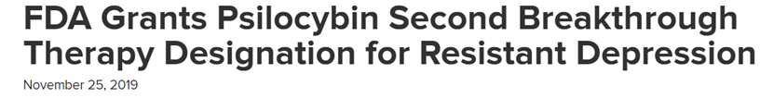
Psilocybin
Depression
” Magic Mushrooms”
COMPASSPathways.com (2018); Medscape.com (2019)

Slide 38
What’s actually going on

Slide 39
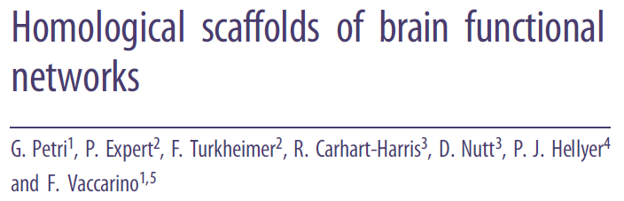
Petri et al. (2014)
Psychedelic Theories
Map the brain’s functional connections
Resting-state functional connectivity using fMRI
n = 15
Psilocybin vs placebo

Slide 40
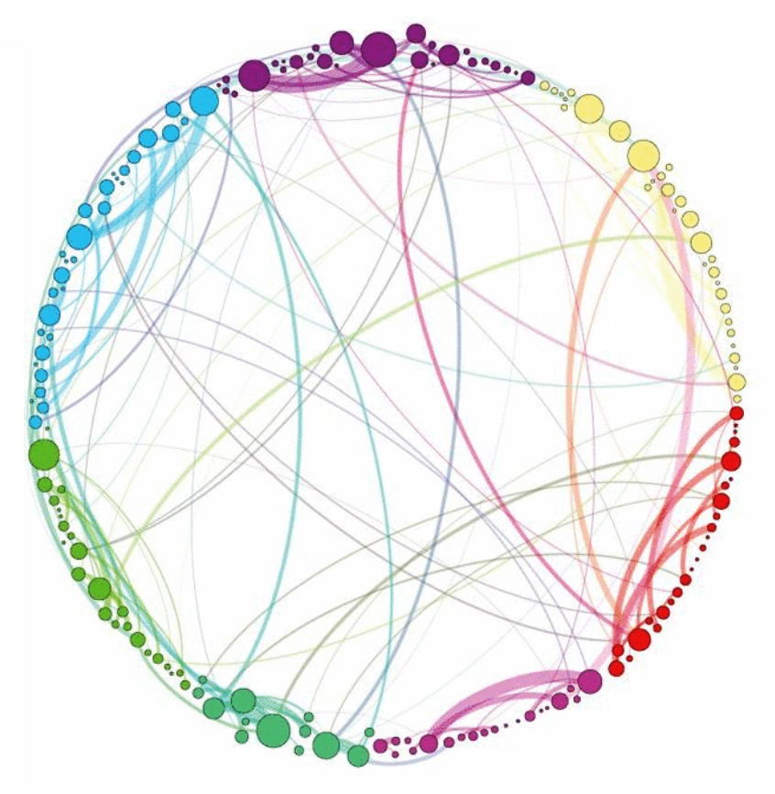
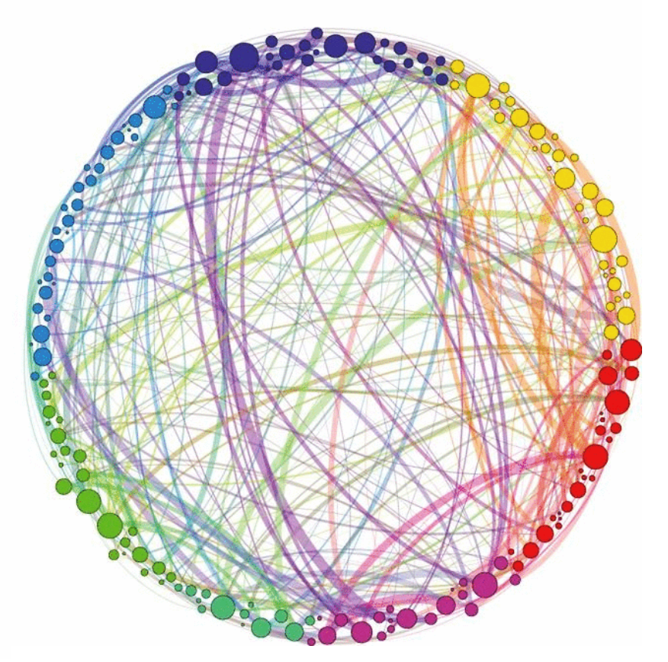
Petri et al. (2014)
Psychedelic Theories
Placebo
Psilocybin

Slide 41
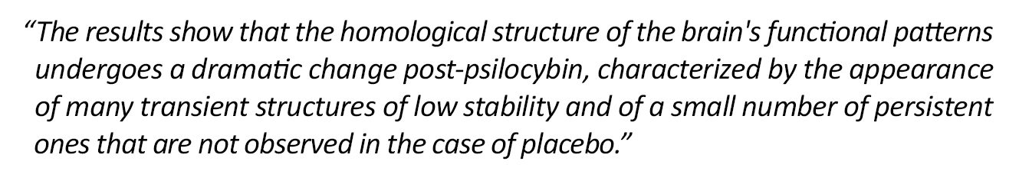
Petri et al. (2014)
Psychedelic Theories
Placebo
Psilocybin

Slide 42
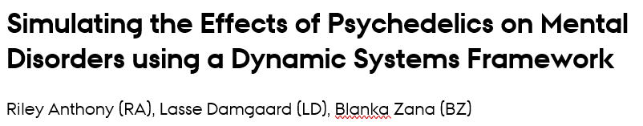
Psychedelic Theories

Slide 43
Psychedelic Theories
1) Issues such as anxiety, addiction, and depression arise from overly stable or rigid cognitive networks
(Borsboom, 2017; Hayes et al., 2015; Sheline et al., 2010).
2) Psychedelic drugs can effectuate the return of a cognitive network to a healthier (i.e. less rigid) state
(Grob et al., 2011; MacLean, Johnson & Griffiths, 2011; Ross et al., 2016).
3) This change is facilitated by a temporary increase in entropy in cognitive network connectivity
(Carhart-Harris et al., 2014; Lebedev et al., 2016; Schartner et al., 2017).

Slide 44
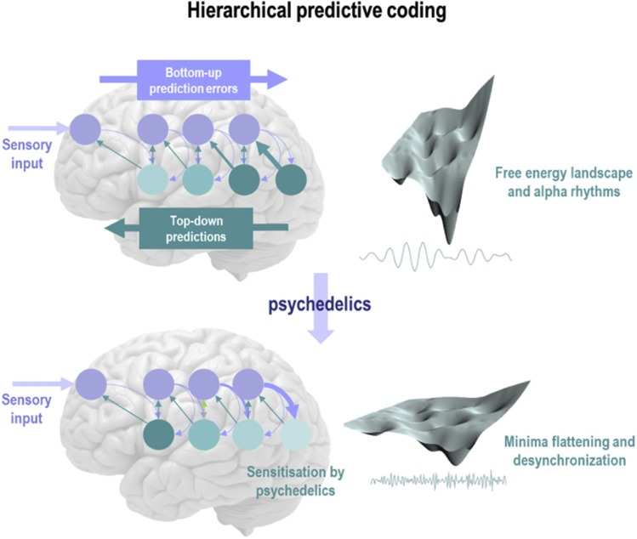
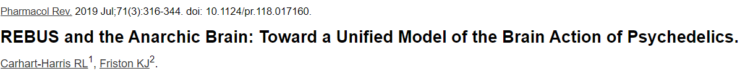
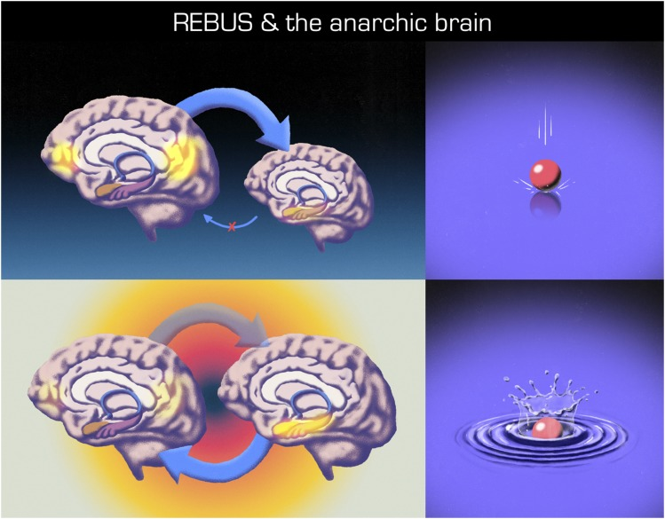
Psychedelic Theories
Carhart-Harris & Friston (2019)
Psychopathologies (e.g. depression) overweight high-level priors
This also causes a suppression of bottom-up signaling
Psychedelics relax high-level priors and beliefs
This enables bottom-up information to travel up the cognitive hierarchy
Carhart-Harris & Friston (2019)

Slide 45
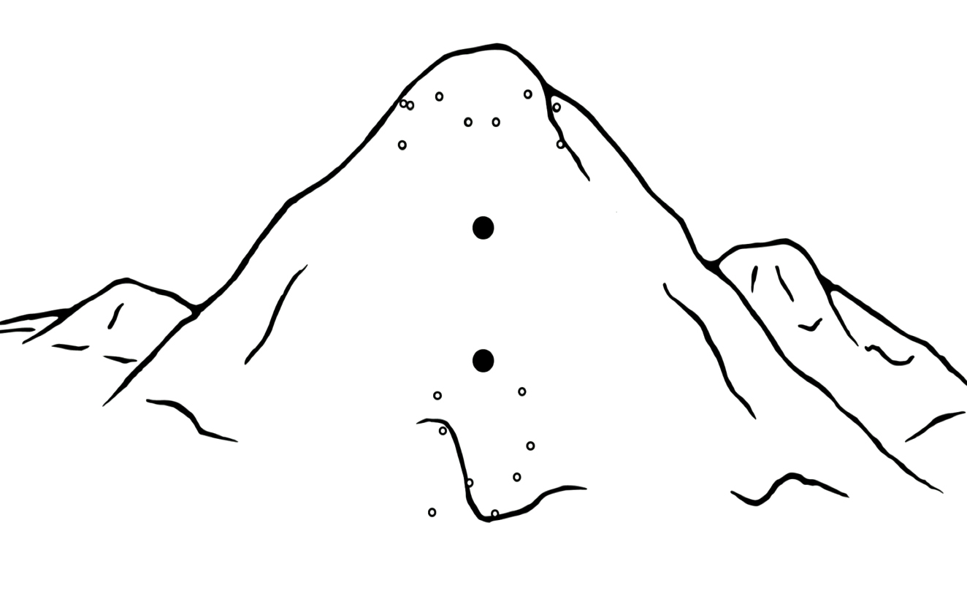
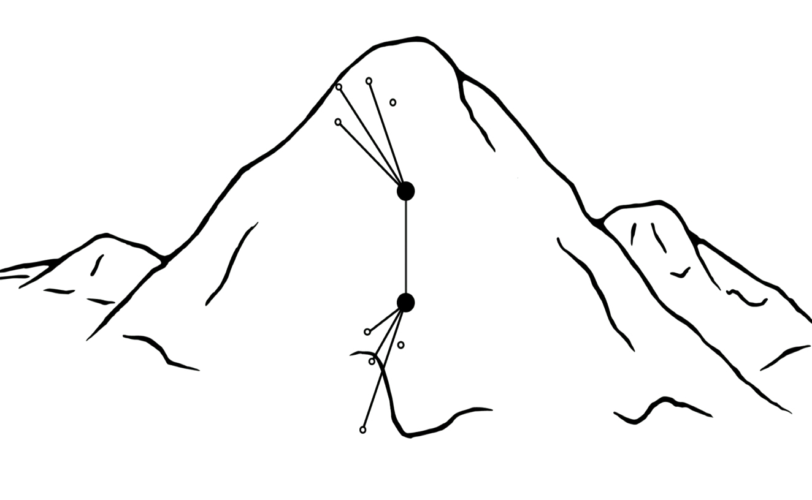
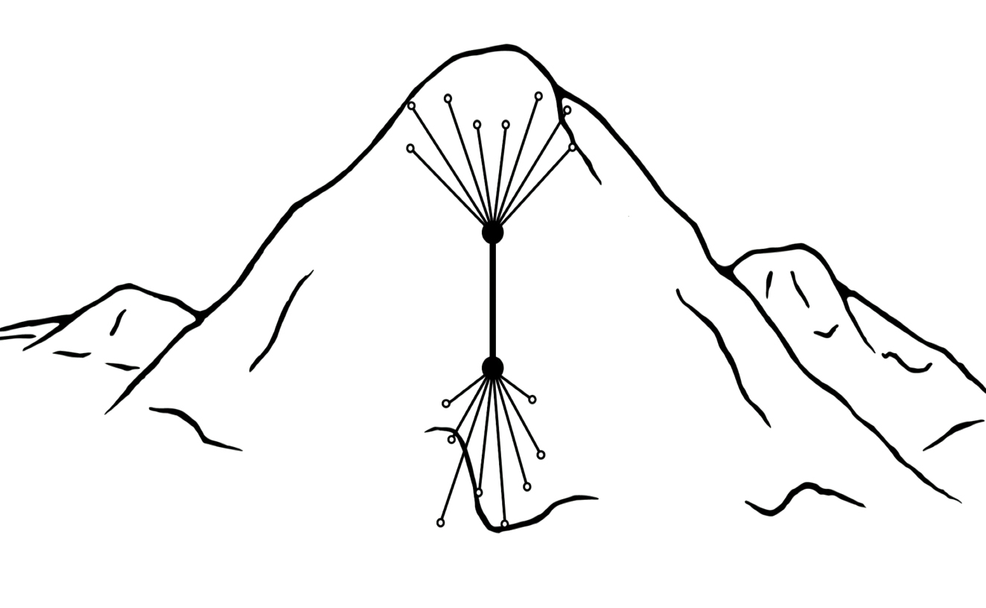
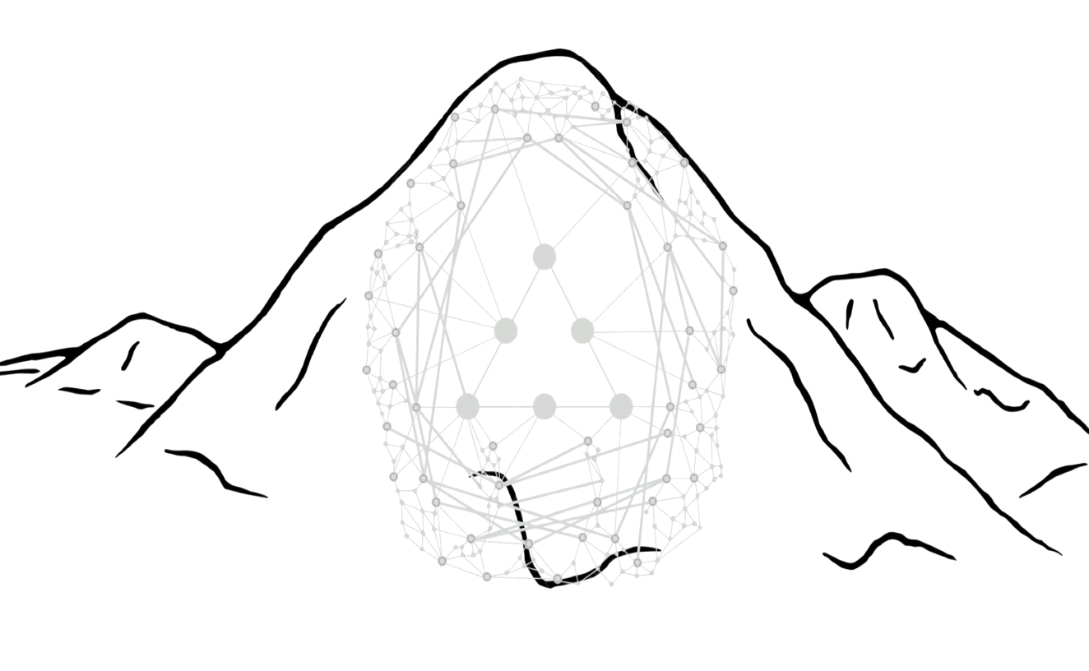

Psychedelic Theories
Kaelen (2017)

Slide 47
But what does it feel like

Slide 48


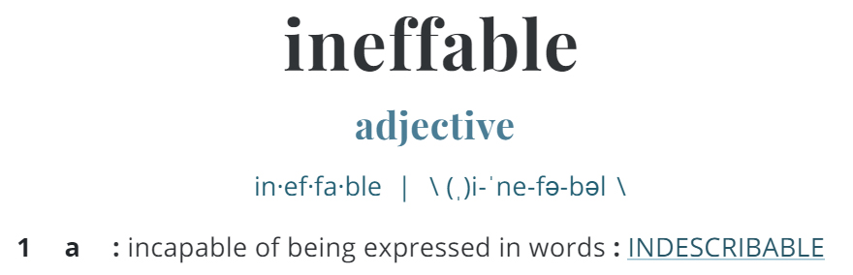

Slide 49
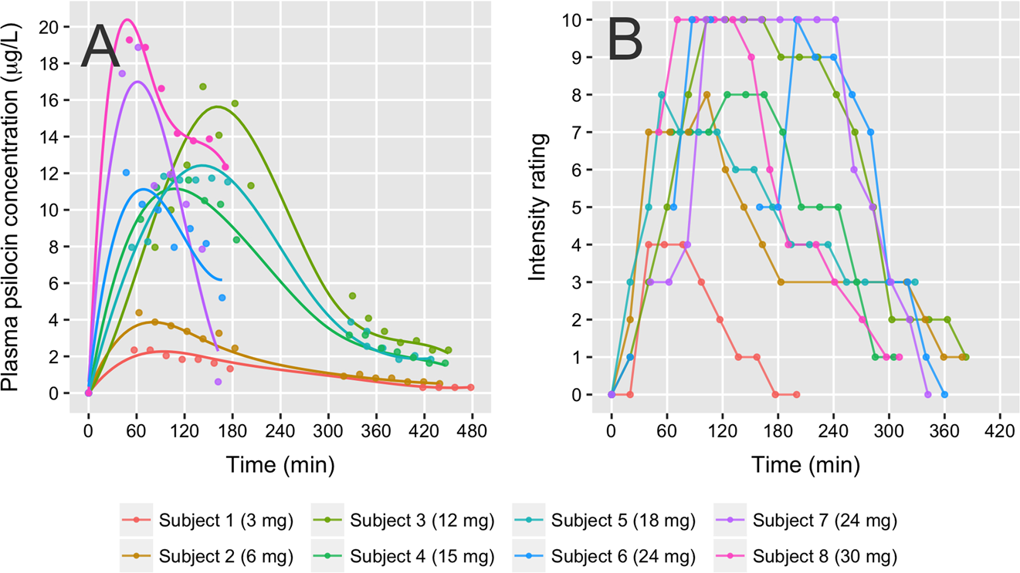
Madsen et al. (2019)
Phenomenology

Slide 50
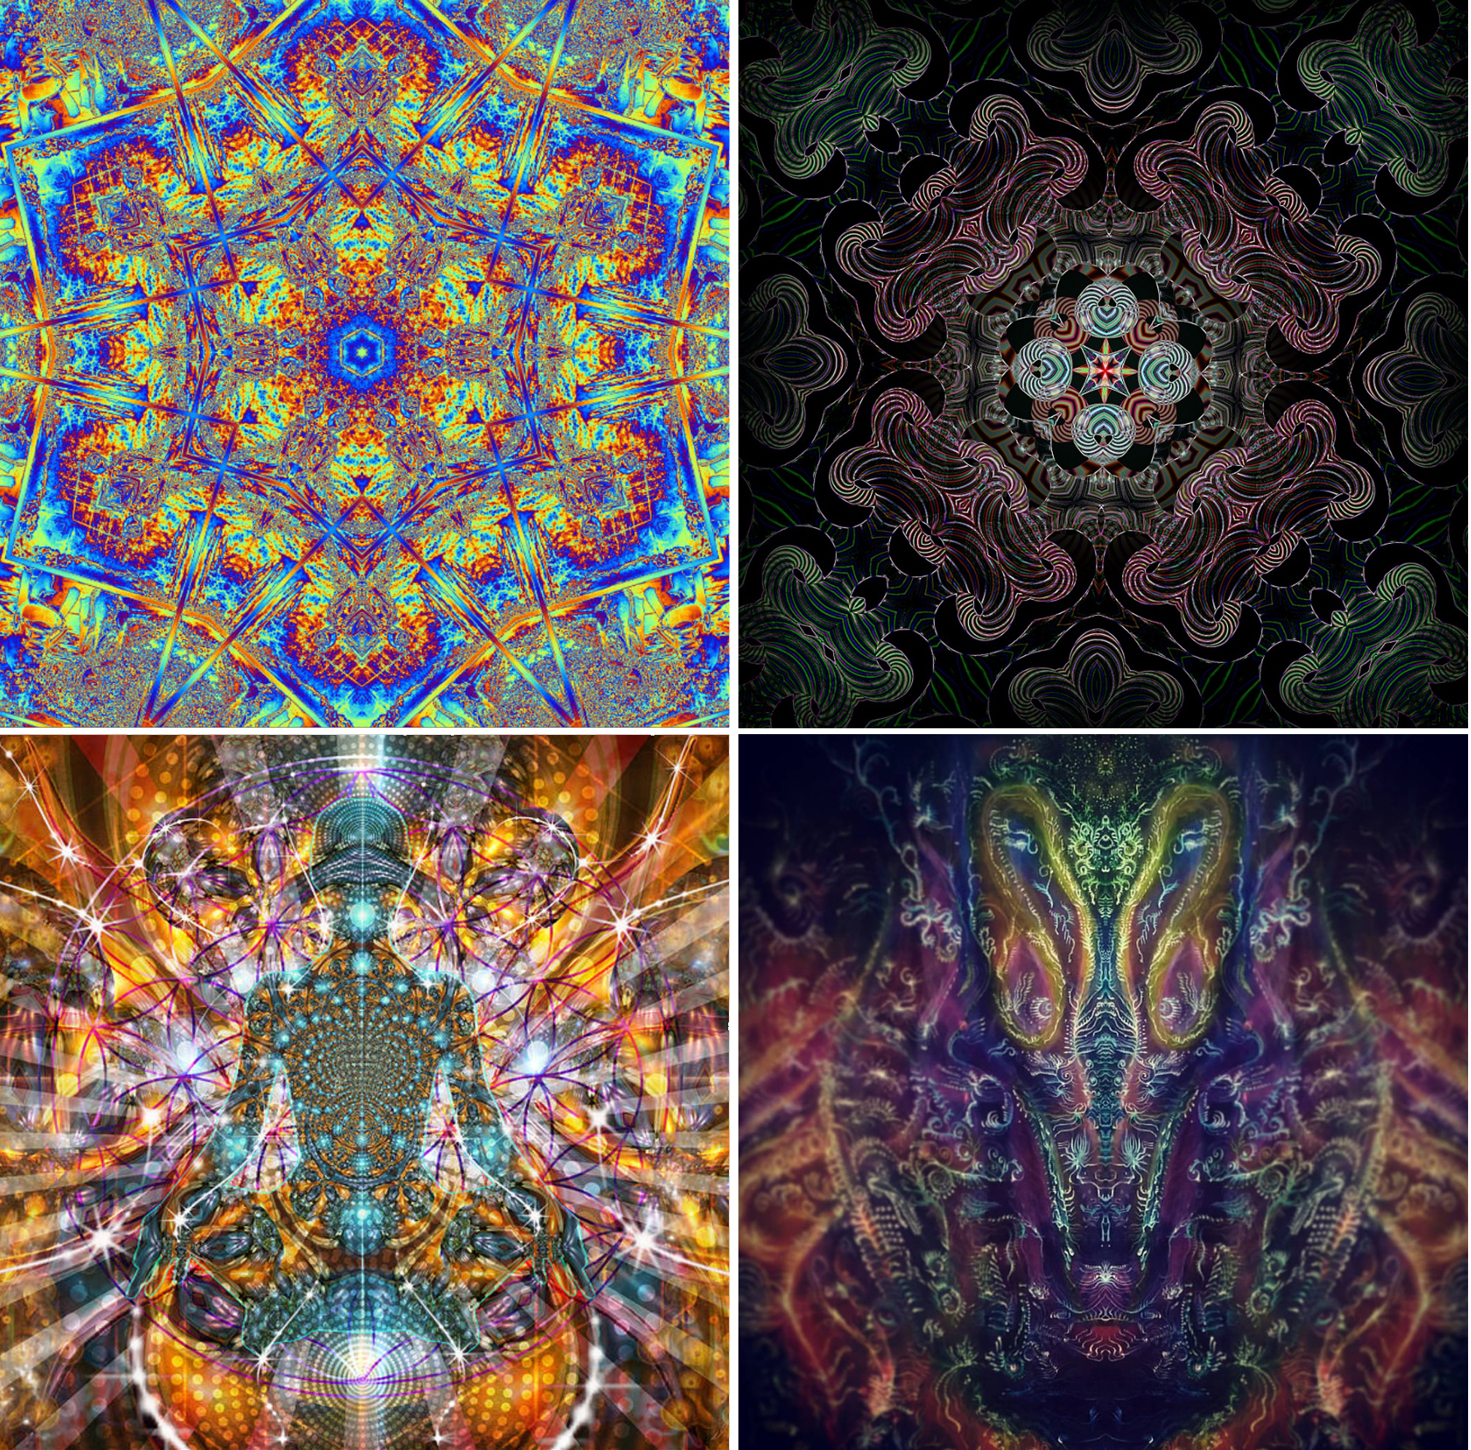
Phenomenology
Google Image Search:
“psychedelic closed-eye visuals”

Slide 51
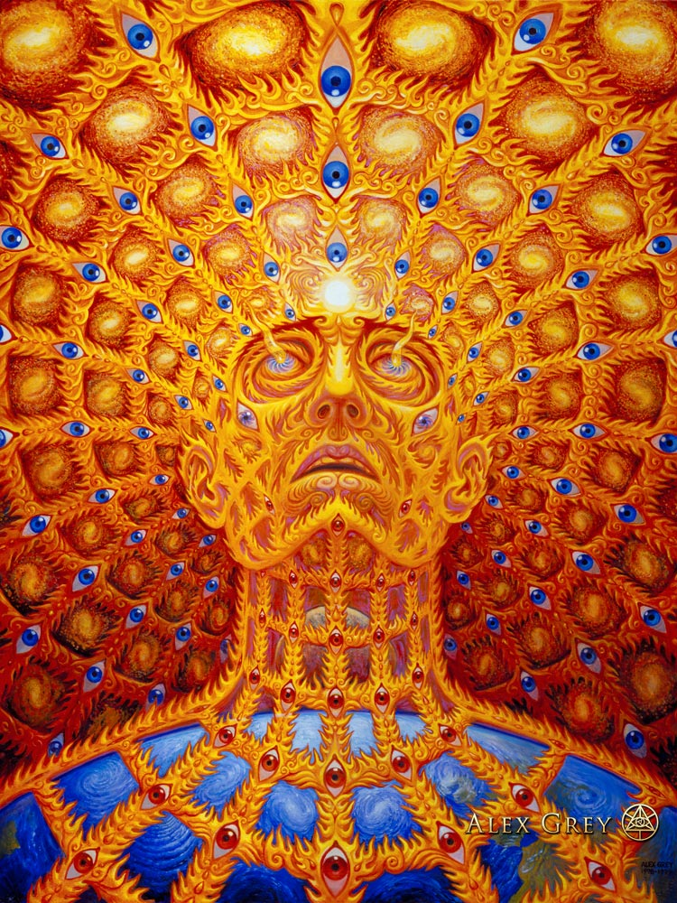
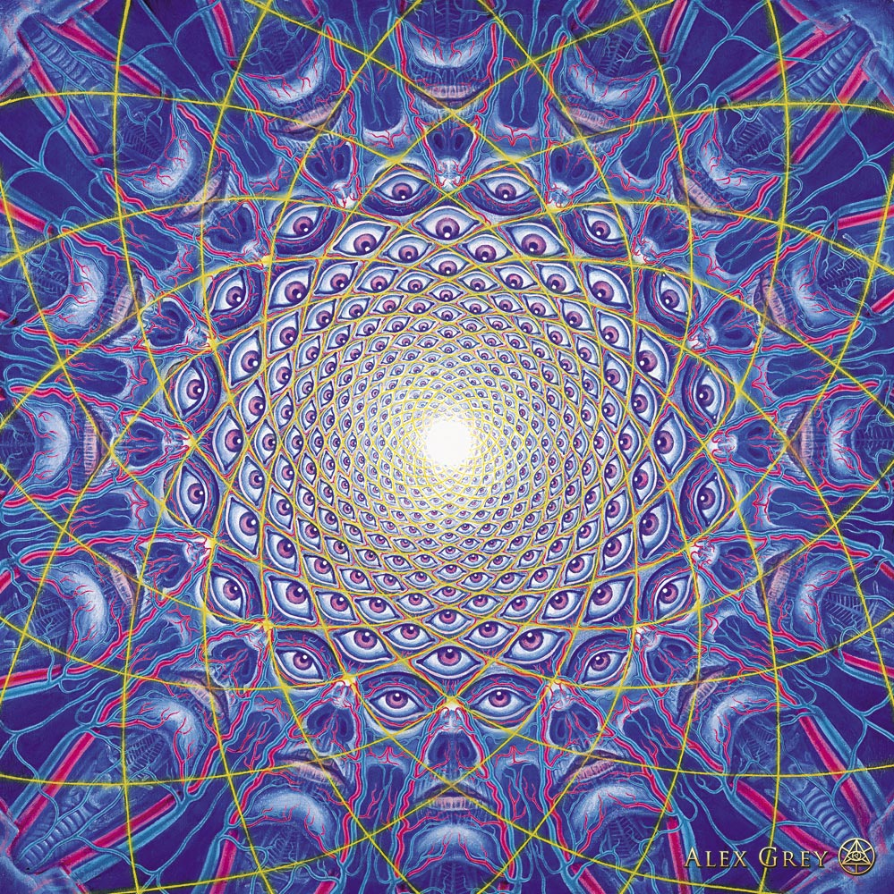
Phenomenology
Grey (1995).

Slide 52
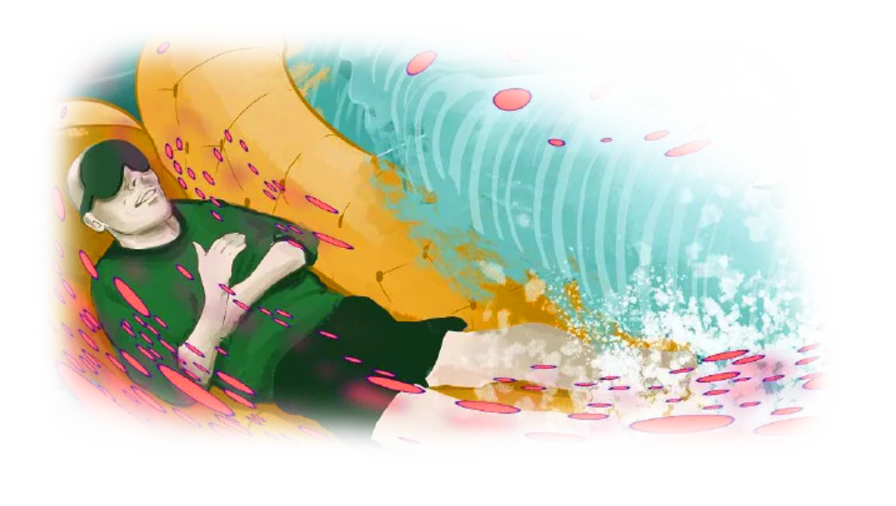
Phenomenology

Slide 53
Phenomenology
“The landscapes I saw were vast and infinite as far as I could tell. I was in the universe that was my mind. Neon strings expanded from my line of sight into incomprehensible depths. (…)
I wished [my guides] could join me in my world because it was stunning.”
Anonymous (2012).

Slide 54
Phenomenology
“I was everybody, unity, one life with 6 billion faces.
I was the one asking for love and giving love.
I was swimming in the sea – and the sea was me.”
Pollan (2018).

Slide 55
Thank you for your attention.

Slide 56
References
Anonymous. (2012). IAMA Current participant in the Johns Hopkins Psilocybin (aka magic mushrooms) Studies (AMA). reddit. Retrieved January 30, 2019, from https://www.reddit.com/r/IAmA/comments/115ewt/iama_current_participant_in_the_johns_hopkins/
Baum, D. (2016). Legalize It All, by Dan Baum; Harper's Magazine. Retrieved 18 February 2020, from https://harpers.org/archive/2016/04/legalize-it-all/
Bogenschutz, M. P., Forcehimes, A. A., Pommy, J. A., Wilcox, C. E., Barbosa, P. C. R., & Strassman, R. J. (2015). Psilocybin-assisted treatment for alcohol dependence: a proof-of-concept study. Journal of Psychopharmacology, 29(3), 289-299.
Carhart-Harris, R. L., Bolstridge, M., Day, C. M. J., Rucker, J., Watts, R., Erritzoe, D. E., Kaelen, M., Giribaldi, B., Bloomfield, M., Pilling, S., Rickard, J. A., Forbes, B., Feilding, A., Taylor, D., Curran, H. V., & Nutt, D. J. (2018). Psilocybin with psychological support for treatment-resistant depression: Six-month follow-up. Psychopharmacology, 235(2), 399–408. https://doi.org/10.1007/s00213-017-4771-x
Carhart-Harris, R. L., & Friston, K. J. (2019). REBUS and the Anarchic Brain: Toward a Unified Model of the Brain Action of Psychedelics. Pharmacological Reviews, 71(3), 316–344. https://doi.org/10.1124/pr.118.017160
Clinical trials: FDA marks psilocybin for depression treatment. (2019). Retrieved 18 February 2020, from https://www.healtheuropa.eu/clinical-trials-fda-marks-psilocybin-for-depression-treatment/95377/
COMPASS Pathways receives FDA Breakthrough Therapy designation for psilocybin therapy for treatment-resistant depression – COMPASS. (2018). Retrieved 18 February 2020, from https://compasspathways.com/compass-pathways-receives-fda-breakthrough-therapy-designation-for-psilocybin-therapy-for-treatment-resistant-depression-2/
FDA Grants Psilocybin Second Breakthrough Therapy Designation. (2019). Retrieved 18 February 2020, from https://www.medscape.com/viewarticle/921789
Grey, A. (1995). Collective Vision [Oil on linen]. Retrieved from https://www.alexgrey.com/art/paintings/soul/
Grey, A. (1999). Oversoul [Oil on linen]. Retrieved from https://www.alexgrey.com/art/paintings/soul/oversoul/alex_grey_oversoul/
Griffiths, R. R., Johnson, M. W., Carducci, M. A., Umbricht, A., Richards, W. A., Richards, B. D., Cosimano, M. P., & Klinedinst, M. A. (2016). Psilocybin produces substantial and sustained decreases in depression and anxiety in patients with life-threatening cancer: A randomized double-blind trial. Journal of Psychopharmacology, 30(12), 1181–1197. https://doi.org/10.1177/0269881116675513
Griffiths, R. R., Richards, W. A., McCann, U., & Jesse, R. (2006). Psilocybin can occasion mystical-type experiences having substantial and sustained personal meaning and spiritual significance. Psychopharmacology, 187(3), 268-283.
Hofmann, A. (1980). LSD, my problem child. New York: McGraw-Hill.
Johnson, M., Garcia-Romeu, A., & Griffiths, R. (2014). Examining the psychological mechanisms of psilocybin-assisted smoking cessation treatment: A pilot study. Drug And Alcohol Dependence, 140, e66. http://dx.doi.org/10.1016/j.drugalcdep.2014.02.200
Kaelen, M. (2017). The psychedelic future of mental health care [Video]. Retrieved from https://www.youtube.com/watch?v=ehi0Cfm4DQM
Krebs, T. S., & Johansen, P.-Ø. (2012). Lysergic acid diethylamide (LSD) for alcoholism: Meta-analysis of randomized controlled trials. Journal of Psychopharmacology, 26(7), 994–1002. https://doi.org/10.1177/0269881112439253
Madsen, M. K., Fisher, P. M., Burmester, D., Dyssegaard, A., Stenbæk, D. S., Kristiansen, S., Johansen, S. S., Lehel, S., Linnet, K., Svarer, C., Erritzoe, D., Ozenne, B., & Knudsen, G. M. (2019). Psychedelic effects of psilocybin correlate with serotonin 2A receptor occupancy and plasma psilocin levels. Neuropsychopharmacology: Official Publication of the American College of Neuropsychopharmacology, 44(7), 1328–1334. https://doi.org/10.1038/s41386-019-0324-9
Petri, G., Expert, P., Turkheimer, F., Carhart-Harris, R., Nutt, D., Hellyer, P., & Vaccarino, F. (2017). Homological scaffolds of brain functional networks.
Pollan, M. (2018). How to Change Your Mind: What the New Science of Psychedelics Teaches Us of Consciousness, Dying, Addiction, Depression, and Transcendence. New York: Penguin Books.
Roseman, L., Nutt, D. J., & Carhart-Harris, R. L. (2018). Quality of Acute Psychedelic Experience Predicts Therapeutic Efficacy of Psilocybin for Treatment-Resistant Depression. Frontiers in Pharmacology, 8. https://doi.org/10.3389/fphar.2017.00974
Rudgley, R. (1993). “Reflecting on intoxication”. In Kolind, T; Thom, B & Hunt, G (eds.) The Sage Handbook of Drug and Alcohol Studies. Pp. 322-336. Sage
Sandison, Ronald (2001). A Century of Psychiatry, Psychotherapy and Group Analysis. London, England: Jessica Kingsley Publishers Ltd. pp. 31–33. ISBN 978-1-85302-869-4.
Sessa, B. (2017). The psychedelic renaissance (2nd ed., p. 328). London: Muswell Hill.Tanne, J. H. (2004). Humphry Osmond. BMJ: British Medical Journal, 328(7441), 713.

Slide 57
But wait – there’s more!

Slide 58


